Slide 1
Exploratory Data Analysis Tables, Graphs and Plots

Slide 2
Exploratory graphs and plots
Visualizing the data via graphics can be important at the beginning stages of data analysis to understand basic properties of the data, to find simple patterns in data, and to suggest possible modeling strategies.
Exploratory graphs are usually made very quickly and a lot of them are made in the process of checking out the data
The goal of making exploratory graphs is usually developing a personal understanding of the data and to prioritize tasks for follow up

Slide 3
Two Types of Variables
A categorical/qualitative variable places an individual into one of several groups or categories
examples:
Gender, Race, Geographic location etc…
A quantitative variable takes numerical values for which arithmetic operations such as adding and averaging make sense
examples:
Height, Age, Salary, Price, Cost etc…
Graphical displays
Qualitative/categorical data: bar chart, pie chart, etc.
Quantitative data: histogram, stem-leaf, boxplot, timeplot etc.
Summary statistics
Qualitative/categorical: contingency tables
Quantitative: mean, median, standard deviation, range etc

Slide 4
Exploring categorical variables
Summary or Frequency table
Note that percentages are often called Relative Frequencies.
R command
table(movie_data$country)
count(movie_data,country)
table(movie_data$country,movie_data$language)
count(movie_data,country,language)

Slide 5
ggplot2 – A plotting system for R
Powerful plotting/visualization package in R
Provides two ways to plot graphs
qplot() is the easier to use function in the ggplot2 package. It is not very customizable, but serves most ordinary needs. It is similar to the plot function in base R.
ggplot() is the main graphing function in the ggplot2 package. It is very flexible and customizable.
Recommend learning gglplot() rather than qplot() even though it is more difficult to use.

Slide 6
ggplot2 grammar of graphics
Grammar Defines Components of Graphics
data: in ggplot2, data must be stored as an R data frame
coordinate system: describes 2-D space that data is projected onto
for example, Cartesian coordinates, polar coordinates, map projections, ...
geoms: describe type of geometric objects that represent data
for example, points, lines, polygons, ...
aesthetics: describe visual characteristics that represent data
for example, position, size, color, shape, transparency, fill
scales: for each aesthetic, describe how visual characteristic is converted to display values
for example, log scales, color scales, size scales, shape scales, ...
stats : describe statistical transformations that typically summarize data
for example, counts, means, medians, regression lines, ...
facets: describe how data is split into subsets and displayed as multiple small graphs

Slide 7
gglplot()
ggplot() creates a plot object that can be assigned to a variable
ggplot() uses an “artist palette” model, where you start with a clean slate and add layers to plot the data, to annotate the graph, overlay a summary etc.
A plot is built up by adding layers
geoms
aesthetics
stats

Slide 8
ggplot()
geoms layer
geom_bar – bar chart
geom_point – scatter plot (points)
geom_histogram() – Histogram
Full list in help and also at http://ggplot2.tidyverse.org/reference/index.html
General form of a command will look like
MyGraph <- ggplot(MyData, aes(variable for x axis, variable for y axis)) + geom()
The + symbol is used to add layers
Certain plots require some statistics such as mean, median etc. You add that by adding a stats layer

Slide 9
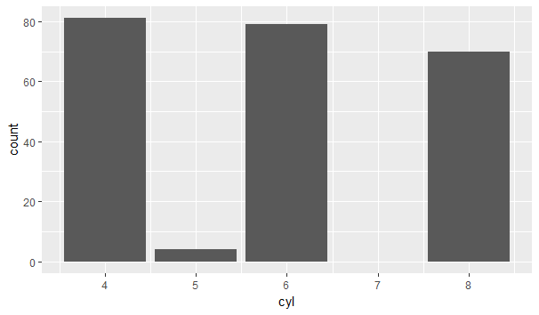
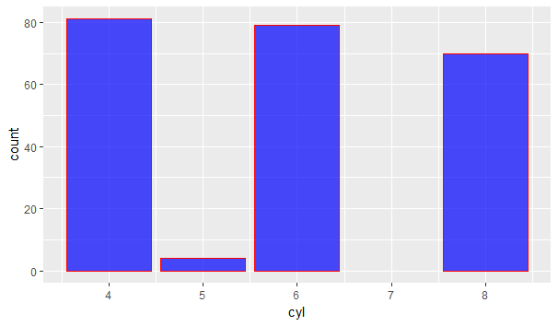
Common graphs used in Exploratory Data Analysis
Graphs for categorical single variables
Bar Charts
ggplot(data=mpg, aes(x=cyl)) + geom_bar()
ggplot(data=mpg, aes(x=cyl)) + geom_bar(color="red", fill=rgb(0,0,1,0.7))

Slide 10
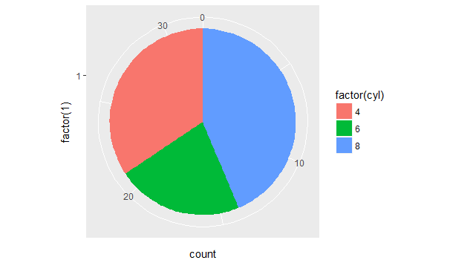
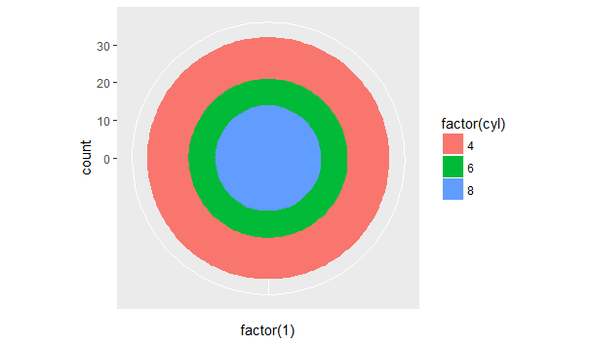
Pie Chart
In ggplot2 a pie chart is a bar chart in polar coordinates
ggplot(mpg, aes(x = factor(1), fill = factor(cyl))) + geom_bar(width = 1) + coord_polar(theta = "y")
ggplot(mpg, aes(x = factor(1), fill = factor(cyl))) + geom_bar(width = 1) + coord_polar()
Pie charts are usually not recommended by statisticians. Bar chart preferred.

Slide 11
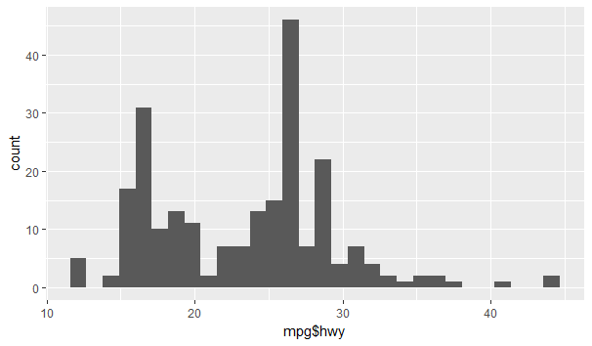
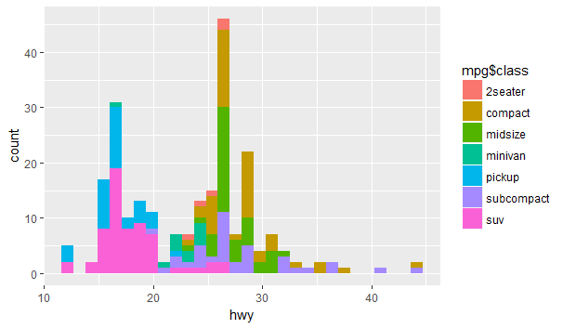
Common graphs used in Exploratory Data Analysis
Graphs for quantitative single variables
Histogram
Similar to a bar chart but a histogram groups numbers into ranges called bins
Used to understand the shape of the distribution of the variable
ggplot(data=mpg, aes(mpg$hwy)) + geom_histogram()
ggplot(data=mpg, aes(mpg$hwy, fill = mpg$class)) + geom_histogram()

Slide 12
Issues with Histograms
For small data sets, histograms can be misleading.
Small changes in the data, bins, or anchor can deceive
For large data sets, histograms can be quite effective at illustrating general properties of the distribution.
Histograms effectively only work with 1 variable at a time
But ‘small multiples’ can be effective

Slide 13
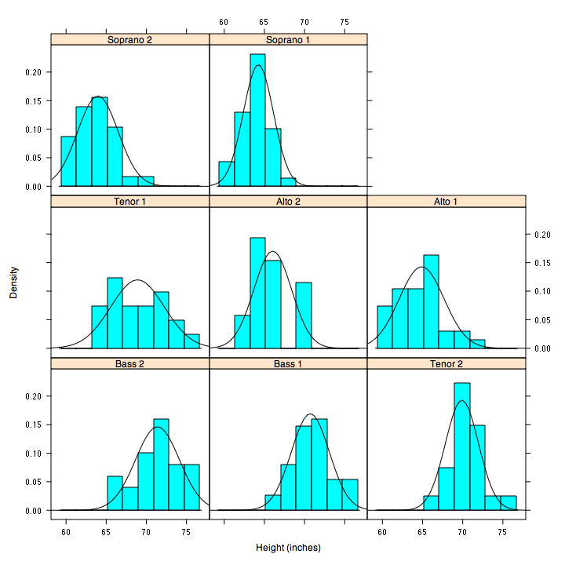
But be careful with axes and scales!

Slide 14
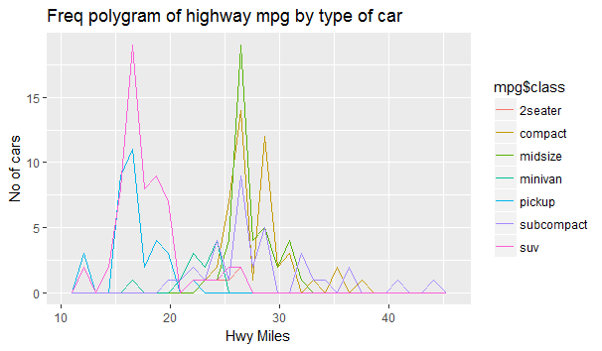
Frequency Polygons
Easier to compare distributions
ggplot(data=mpg, aes(hwy, color = mpg$class)) + geom_freqpoly()
Now let us add a title to the graph and label the x and y axis
To add title add title layer with + ggtitle()
ggplot(data=mpg, aes(hwy, color = mpg$class)) + geom_freqpoly() + ggtitle("Freq polygram of highway mpg by type of car")
To add labels add a labels layer with +labs()
ggplot(data=mpg, aes(hwy, color = mpg$class)) + geom_freqpoly() + ggtitle("Freq polygram of highway mpg by type of car") + labs(x="Hwy Miles", y="No of cars")

Slide 15
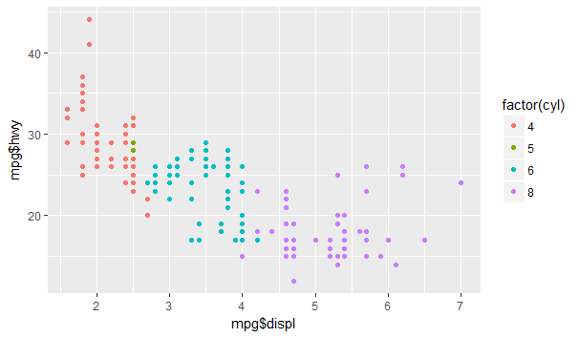
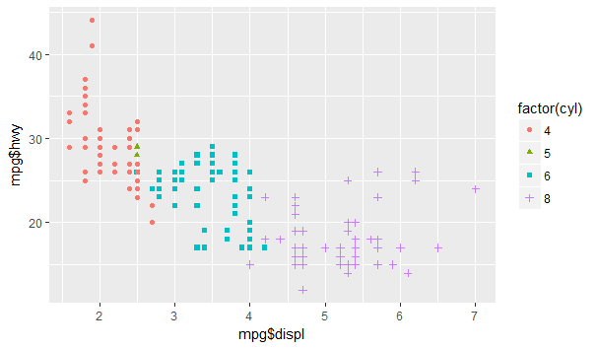
Plots for exploring two or more variables
Scatter Plot
ggplot(data=mpg, aes(mpg$displ,mpg$hwy, color = factor(mpg$cyl))) + geom_point()
ggplot(data=mpg, aes(mpg$displ,mpg$hwy, color = factor(mpg$cyl), shape = factor(cyl))) + geom_point()
Form
Linear, quadratic, exponential
Direction
Positive association
An increase in one variable is accompanied by an increase in the other
Negatively associated
A decrease in one variable is accompanied by an increase in the other
Strength
How closely the points follow a clear form

Slide 16
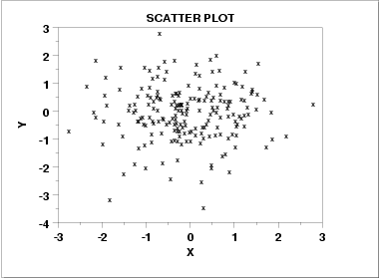
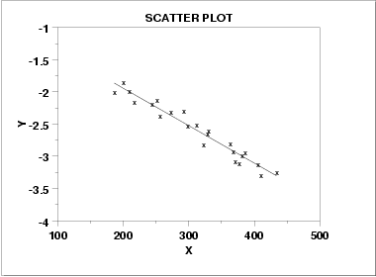
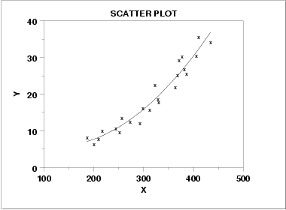
Scatter Plot: Relationships

Slide 17
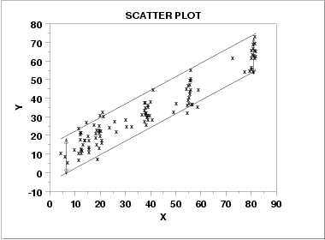
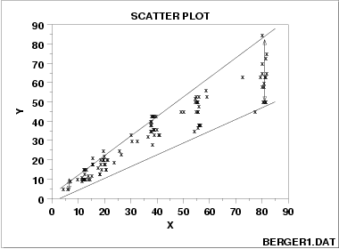
Scatter plot:
Heteroscedastic: variation in Y differs depending on the value of X
e.g., Y = annual tax paid, X = income
Homoscedastic: variation is constant

Slide 18
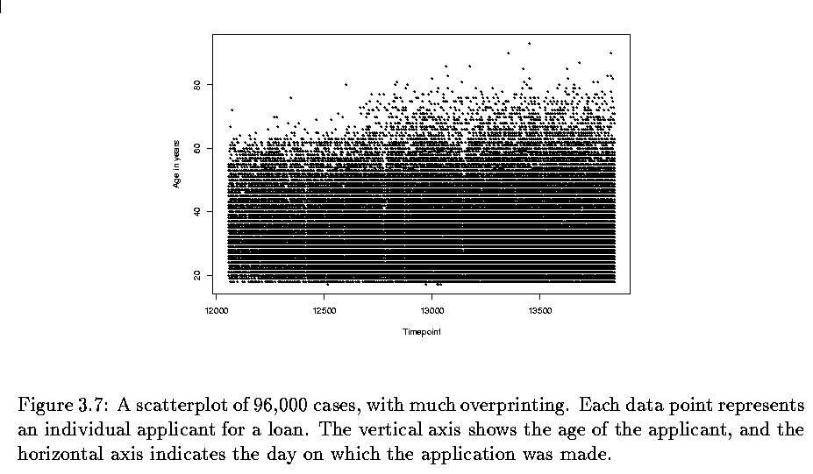
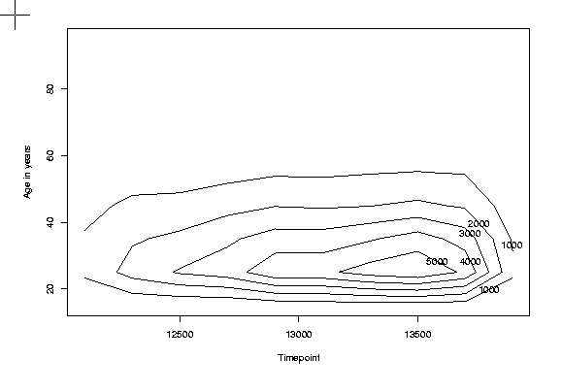
Scatter Plots
Scatterplots can be bad when there is lots of data
What to do for large data sets?
Contour plots

Slide 19
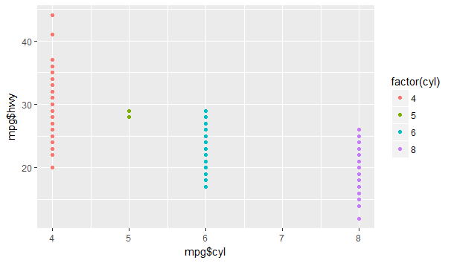
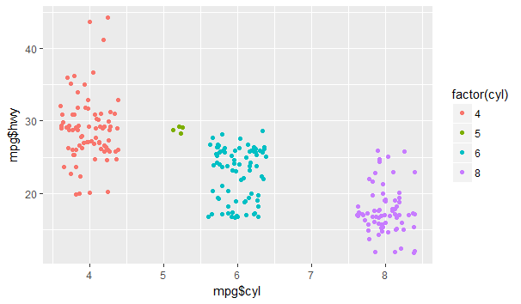
Stripchart
ggplot(data=mpg, aes(mpg$cyl,mpg$hwy, color = factor(cyl))) + geom_point()
Jittering
The points are on top of one another, so, introduce some random noise to see the points clearly
ggplot(data=mpg, aes(mpg$cyl,mpg$hwy, color = factor(cyl))) + geom_point() + geom_jitter()

Slide 20
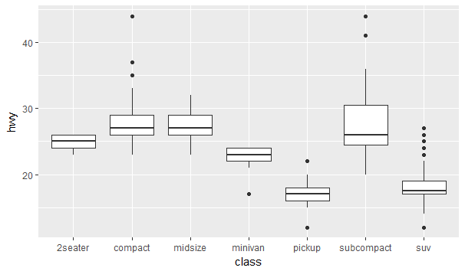
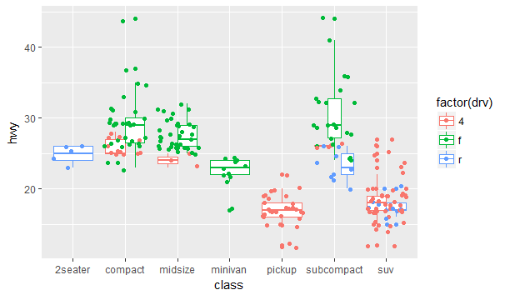
Box Plot
A box plot is a graph of five numbers (often called the five number summary)
minimum
Maximum
Median
1st quartile
3rd quartile
ggplot(mpg, aes(class, hwy)) + geom_boxplot()
ggplot(mpg, aes(class, hwy, color = factor(drv))) + geom_boxplot() + geom_jitter()

Slide 21
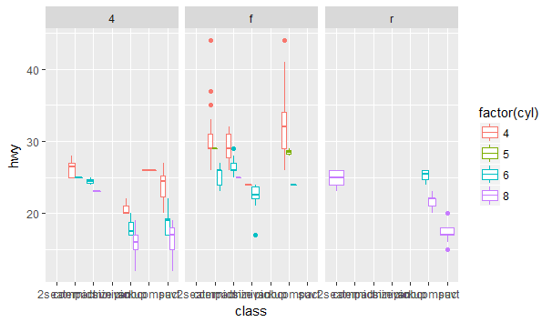
Side by Side Box Plots
Add a facet layer
Helps with comparisons
You can facet any type of graphs
ggplot(mpg, aes(class, hwy, color = factor(cyl))) + geom_boxplot() + facet_grid(~drv)

Slide 22
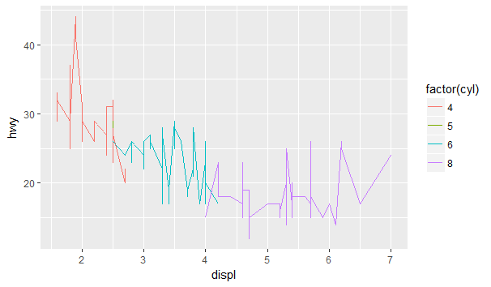
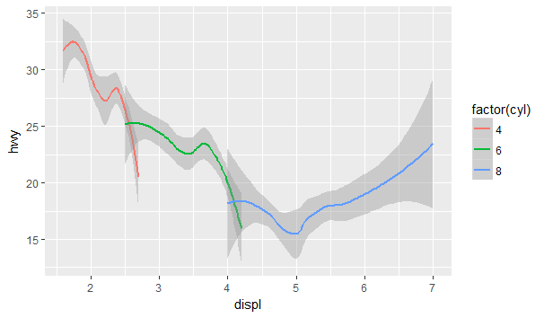
Line graphs
ggplot(mpg, aes(displ, hwy, color = factor(cyl))) + geom_line()
ggplot(mpg, aes(displ, hwy, color = factor(cyl))) + geom_smooth()

Slide 23
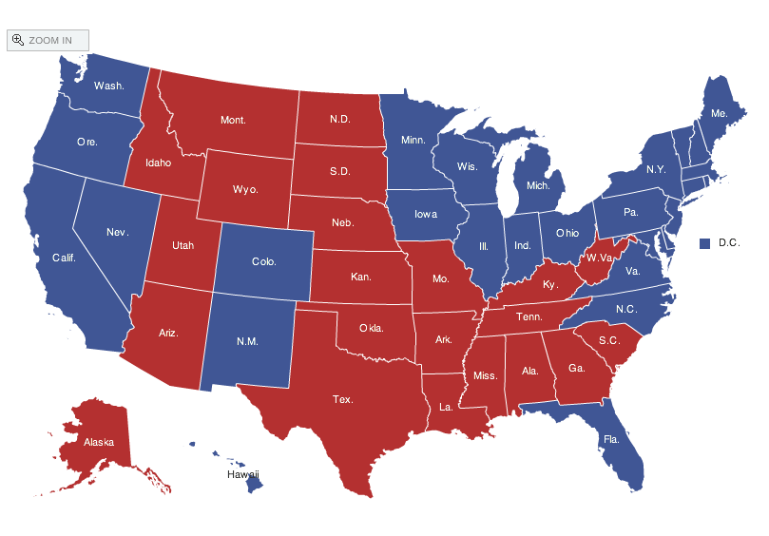
Spatial data: choropleth Maps
Maps using color shadings to represent numerical values are called choropleth maps
crimes <- data.frame(state = tolower(rownames(USArrests)), USArrests)
states_map <- map_data("state")
ggplot(crimes, aes(map_id = state)) +
geom_map(aes(fill = Assault), map=states_map) +
expand_limits(x = states_map$long, y = states_map$lat)

Slide 24
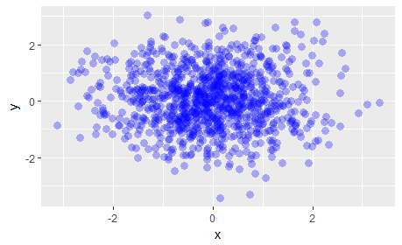
Transparent plotting
Alpha-blending:
df <- data.frame(x = rnorm(1000), y = rnorm(1000))
ggplot(df, aes(x,y)) + geom_point(alpha=0.3,col="#0000ff22", pch=16,cex=3)
pch – plotting chrater, cex – size of the plotting character, alpha - transparency

Slide 25
Exploratory graphs with qplot()
Scatter plot
qplot(State.Name, pm25,data=pm2.5njny, geom = "point")
Box Plot
qplot(State.Name,pm25,data=pm2.5njny, geom = "boxplot")
Histogram
qplot(pm25,data=pm2.5njny, geom = "histogram", fill = State.Name)
Frequency Polygon
qplot(pm25,data=pm2.5njny, geom = "freqpoly", fill = State.Name)
Density
qplot(pm25,data=pm2.5njny, geom = "density", color = State.Name)
Bar Chart
qplot(County.Name,data=pm2.5njny, geom = "bar", fill = State.Name)
Facets
qplot(pm25,data=pm2.5njny, geom = "histogram", facets = ~State.Name)

Slide 26
Readings
Exploratory Data Analysis with R by Roger Peng
Chapter 15 and 16
References
http://ggplot2.tidyverse.org/index.html
http://www.cookbook-r.com/Graphs/
http://r4ds.had.co.nz/data-visualisation.html

Slide 27
Practice Exercise / HW
Use the diamonds dataset that comes with R
Count the number of rows by clarity
What are the unique values for cut?
Tabulate the frequency (no of diamonds) by cut
Find the mean carat size by color
Use a bar chart to find which cut has the most amount of diamonds
Check the distribution of the carat size. How can you describe the distribution?
Is there a relationship between carat size and price? Check using a graph.
Which color has the maximum variability in the price? Use a graph to find out.

